Slide 1
Database Security

Slide 2
What is View
Views are virtual only and run the query definition each time they are accessed.
It is a logical view of your tables, with no data stored anywhere else.
Views are essentially logical table-like structures populated on the fly by a given query. The results of a view query are not stored anywhere on disk and the view is recreated every time the query is executed
Create view Syntax:
CREATE VIEW view_name AS SELECT columns FROM table WHERE conditions;
Example: create view a_view as select * from a_student;

Slide 3
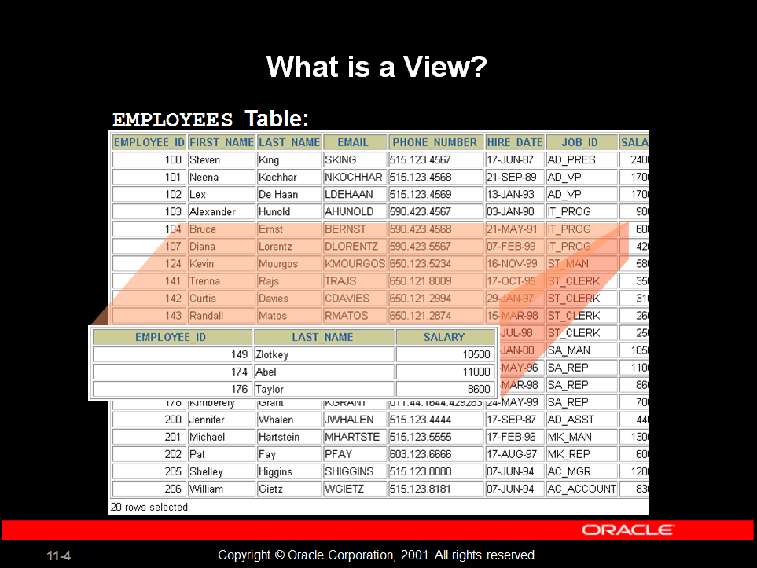
View

Slide 4
View Retrieval/ Update
This Oracle CREATE VIEW example would create a virtual table based on the result set of the SELECT statement. You can now query the Oracle VIEW as follows:
select * from a_view;
You can modify the definition of an Oracle VIEW without dropping it by using the Oracle CREATE OR REPLACE VIEW Statement
CREATE OR REPLACE VIEW view_name AS SELECT columns FROM table WHERE conditions;
create or replace will update view if view exists, if doesn’t then it creates a view
Example: create or replace view a_view1 as select sid from a_student where sid>=102;

Slide 5
Drop View
To drop a created view
drop view view_name;
Example: drop view a_view1;
Question: Can you update the data in an Oracle VIEW?
Answer: A VIEW in Oracle is created by joining one or more tables. When you update record(s) in a VIEW, it updates the records in the underlying tables that make up the view. So, yes, you can update the data in an Oracle VIEW providing you have the proper privileges to the underlying Oracle tables.

Slide 6
Question: Does the Oracle View exist if the table is dropped from the database?
Answer: Yes, in Oracle, the VIEW continues to exist even after one of the tables (that the Oracle VIEW is based on) is dropped from the database. However, if you try to query the Oracle VIEW after the table has been dropped, you will receive a message indicating that the Oracle VIEW has errors.
If you recreate the table (the table that you had dropped), the Oracle VIEW will again be fine.

Slide 7
Materialized View
Materialized view (MV) is indirect access to table data by storing the result of a query in a separate schema object.
It can be stored in the same db or in different db.
MV stored in same db as their master tables can improve performance through query rewrite. For queries that involve aggregate data or join the optimizer can rewrite the query to access the precomputed results stored in MV.
Query rewrite is particularly useful in data warehouse.
Another name of mv is snapshot.
MV are schema object that is used to summarize, precompute, replicate, distribute data.
Suitable in data warehouse, decision support, distributed & mobile computing.
They consume storage
Must be refreshed when data in master table changes.
Their existent is transparent to sql application & user.
Having limitation: support for incremental refresh.

Slide 8
Differentiate view and materialized view
view | Materialized view
are virtual only and run the query definition each time they are accessed | are disk based and update periodically base upon the query definition.
Views evaluate the data in the tables underlying the view definition at the time the view is queried
It is a logical view of your tables, with no data stored anywhere else. | Materialized views are similar to regular views
The upside of a view is that it will always return the latest data to you. | The upside of this is this is that when you query a materialized view, you are querying a table, which may also be indexed
 | with query rewrite enabled, Oracle can optimize a query that selects from the source of your materialized view in such a way that it instead reads from your materialized view

Slide 9
The downside of a view is that its performance depends on how good a select statement the view is based on. If the select statement used by the view joins many tables, or uses joins based on non-indexed columns, the view could perform poorly. | The downside though is that the data you get back from the materialized view is only as up to date as the last time the materialized view has been refreshed.
 | Materialized views can be set to refresh manually, on a set schedule, or based on the database detecting a change in data from one of the underlying tables.
 | Materialized views are most often used in data warehousing / business intelligence applications where querying large fact tables with thousands of millions of rows would result in query response times that resulted in an unusable application.
Views are essentially logical table-like structures populated on the fly by a given query. The results of a view query are not stored anywhere on disk and the view is recreated every time the query is executed | Materialized views are actual structures stored within the database and written to disk. They are updated based on the parameters defined when they are created.

Slide 10
Limitation & Syntax of Materialized View
Support for incremental refresh is limited.
Syntax
CREATE MATERIALIZED VIEW view-name
BUILD [IMMEDIATE | DEFERRED]
REFRESH [FAST | COMPLETE | FORCE ]
ON [COMMIT | DEMAND ]
[[ENABLE | DISABLE] QUERY REWRITE]
[ON PREBUILT TABLE]
AS
SELECT ...;

Slide 11
The BUILD clause options are shown below.
IMMEDIATE : The materialized view is populated immediately.
DEFERRED : The materialized view is populated on the first requested refresh.
The following refresh types are available.
FAST : A fast refresh is attempted. If materialized view logs are not present against the source tables in advance, the creation fails.
COMPLETE : The table segment supporting the materialized view is truncated and repopulated completely using the associated query.
FORCE : A fast refresh is attempted. If one is not possible a complete refresh is performed.
A refresh can be triggered in one of two ways.
ON COMMIT : The refresh is triggered by a committed data change in one of the dependent tables.
ON DEMAND : The refresh is initiated by a manual request or a scheduled task.
The QUERY REWRITE clause tells the optimizer if the materialized view should be consider for query rewrite operations.
The ON PREBUILT TABLE clause tells the database to use an existing table segment, which must have the same name as the materialized view and support the same column structure as the query

Slide 12
Create materialized view
Example: create materialized view a_mv1 build immediate refresh fast on commit as select sid from a_student;
Error: ORA-01031: insufficient privileges, on a_student
It's easier to GRANT or REVOKE privileges to the users through a role rather than assigning a privilege directly to every user. If a role is identified by a password, then, when you GRANT or REVOKE privileges to the role, you definitely have to identify it with the password.

Slide 13
Authentication vs Authorization
Authentication | Authorization
Authentication verifies who you are | Authorization verifies what you are authorized to do.
For example, you can login | For example, you are allowed to login into your Unix server via ssh client, but you are not authorized to browser /data2 or any other file system.
 | Authorization occurs after successful authentication
 | Authorization can be controlled at file system level or using various application level configuration
Authentication: I am an employee of the company. Here is my ID badge. | Authorization: As an employee of the company, I am allowed entrance into the building.

Slide 14
Authorization:
Privileges
System privileges
Each system privilege allows a user to perform a particular database operation or class of database operations; for example, the privilege to create tablespaces is a system privilege.
Object privileges
Each object privilege allows a user to perform a particular action on a specific object, such as a table, view, sequence, procedure, function, or package
Roles
Storage setting and Quotas ( Default Tablespace, Temporary Tablespace
Tablespace Quotas, Profiles and Resource Limits )

Slide 15
Data Encryption
Data encryption is the act of changing electronic information into an unreadable state by using algorithms or ciphers.
Over time as the public has begun to enter and transmit personal, sensitive information over the internet, data encryption has become more widespread

Slide 16
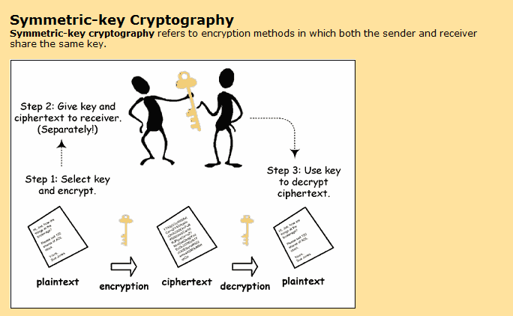

Slide 17
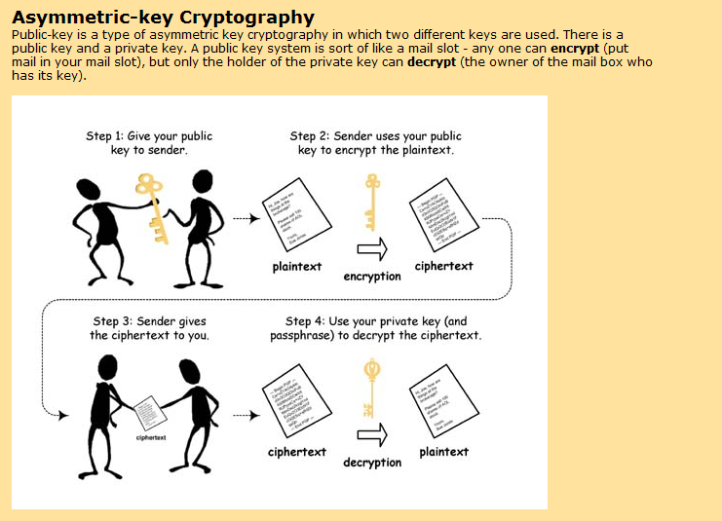

Slide 18
RSA
The RSA algorithm, introduced in 1977 by Rivest, Shamir, and Adlemen, is an algorithm for public-key cryptography.
RSA was the first and is still the most widely-used algorithm for public key cryptography and it is used for thousands of applications from e-mail encryption to secure online purchasing.
It was the first cryptosystem to enable senders to “sign” each message they send so that the recipient has proof of who sent the message.

Slide 19
RSA (Choosing Public / Private Key)
Pick two large (100 digit) primes p and q.
Let n = p*q
Select a relatively small integer e that is prime to Phi ϕ(n) = (p-1)(q-1) ,
1 < e < ϕ(n)
Find d, the multiplicative inverse of e that is relatively prime to the Phi
That is inverse of public key
[e* d mod [ϕ(n) = 1]

Slide 20
RSA …..
(e,n) is the public key. To encrypt M, compute
En(M) Cipher = Me(mod n)
(d,n) is the private key. To decrypt C, compute
De(C) Pt = C^{d}(mod n)

Slide 21
Let p = 11, q = 5
n = pq = 55
phi(n)= (p-1)(q-1) = 40 == { 3, 7 , 9, 11…}
Possible e:, … (let’s use 7)
Find d: 7*d (mod(40)) = 1 .(apply Euclidean algo.)
Public key: (7, 55)
Private key: (23, 55)
Message=3
En(42) = 3^7 (mod 55) = 42
De(81) = 42^23(mod 55) = 3

Slide 22
Let p = 11, q = 13
n = pq = 143
phi(n)= (p-1)(q-1) = 120 = 3 x 23 x 5
Possible e: 7, 11, 13, 17, … (let’s use 7)
Find d: 7*d = 1(mod 120) = 103 e*d=1 mod phi(n)
Public key: (7, 143)
Private key: (103, 143)
Message=h=7
En(42) = 7^7 (mod 143) = 6
De(81) = 6^103(mod 143) = 7

Slide 23
Strengths of RSA
No prior communication needed
Highly secure (for large enough keys)
Well-understood
Allows both encryption and signing
The security of the RSA algorithm and messages encrypted using the algorithm relies on the difficulty of factoring the value of n. If n could be easily factored into the corresponding values of p and q, then one could easily find the value of d.
The RSA Assumption is that the RSA Problem is hard to solve when n is sufficiently large and randomly generated.

Slide 24
Missing Information

Slide 25
ID | Name | Marital Status | Salary
1 | A | Married
2 | B |  | 15000
3 |  | Unmarried | 23000
Sometimes we don’t know what value an entry in a relation should have
We know that there is a value, but don’t know what it is
There is no value at all that makes any sense

Slide 26
Two main methods have been proposed to deal with this
NULLs can be used as markers to show that information is missing
A default value can be used to represent the missing value
NULL’s
NULL is a placeholder for missing or unknown value of an attribute. It is not itself a value.
Codd proposed to distinguish two kinds of NULLs:
A-marks: data Applicable but not known (for example, someone’s age)
I-marks: data is Inapplicable (telephone number for someone who does not have a telephone, or spouse’s name for someone who is not married)

Slide 27
Problems with NULLs
Additional problems for SQL: do we treat NULLs as duplicates? Do we include them in count, sum, average and if yes, how? How do arithmetic operations behave when an argument is NULL?
Theoretical solutions
Use three-valued logic instead of classical two-valued logic to evaluate conditions.
When there are no NULLs around, conditions evaluate to true or false, but if a null is involved, a condition will evaluate to the third value (‘undefined’, or ‘unknown’ or ‘unk’).

Slide 28
Default values are an alternative to the use of NULLs
If a value is not known a particular placeholder value - the default - is used
These are actual values, so don’t need 3VL etc.

Slide 29
Boolean Operators
and | t | u | f
T | t | u | F
U | t | u | F
f | f | f | f
or | t | u | f
T | t | t | t
U | t | u | u
f | t | u | f
not
T | f
U | u
f | t

Slide 30
3 Value Logic-3VL
X | Y | X AND Y | X OR Y | NOT X
T | T | T | T | F
T | U | U | T | F
T | F | F | T | F
U | T | U | T | U
U | U | U | U | U
U | F | F | U | U
F | T | F | T | T
F | U | F | U | T
F | F | F | F | T

Slide 31
For example A=3, B=4 and C=unk
Check
a>b and b>c= 3>4 and 4>unk=f and unk=f
a>b or b>c=3>4 or 4 > unk=f or unk=unk
A<b or b<c=3<4 or 4<unk=t or unk=t
not(A=c)=not(3=unk)=not(unk)=unk

Slide 32
Maybe Boolean Operator
Maybe
T | f
U | t
f | f

Slide 33
Exists expression
If r is a relation with tuples t(1),t(2),…,t(m)
V is a range variable that range over r
P(v) is a Boolean expression in which v occurs as a free variable
Then the expression:::
Exists V(p(v)) is defined to be equivalent to False or (p(t1) or p(t2) or… or p(tm))

Slide 34
ID | Name | Marital Status | Salary
1 | A | Married
2 | B |  | 15000
3 |  | Unmarried | 23000
Exists (Marital_status=Married)
=f or (t or unk or f)
=f or t
=t
Exists (Maybe((Marital_status=Married) ))
=f or (maybe(t) or maybe(unk) or maybe(f))
=f or (f or t or f)
=f or t
=true

Slide 35
ForAll expression
If r is a relation with tuples t(1),t(2),…,t(m)
V is a range variable that range over r
P(v) is a Boolean expression in which v occurs as a free variable
Then the expression:::
ForAll V(p(v)) is defined to be equivalent to true and (p(t1) and p(t2) and… and p(tm))

Slide 36
ID | Name | Marital Status | Salary
1 | A | Married
2 | B |  | 15000
3 |  | Unmarried | 23000
Forall (Marital_status=Married)
=t and (t and unk and f)
=t and f
=f

Slide 37
IS_UNK operator
It takes a single scaler operand and returns true if that operand evaluates to unk otherwise false
ID | Name | Marital Status | Salary
1 | A | Married
2 | B |  | 15000
3 |  | Unmarried | 23000
Exists (IS_UNK(name)
=f or (f or f or t)
=t
Forall(IS_UNK(name)
=t and (f and f and t)
=f

Slide 38
IF_UNK operator
IF_UNK operator takes 2 scaler operands and return the value of 1st operand unless that operand evaluates to unk
IF_UNK(exp1,exp2)= IF_UNK(exp1) then return exp2 else exp1;
Note: exp1 & exp2 must be of same type
Example:::: IF_UNK k(name,’no name’)
Whenever name is unknown ‘no name’ will be the default value

Slide 39
UNK== unk ?
UNK= the value unknown
unk=the unknown truth value
X is a boolean variable can have values like true, false or unk.
“x is unk”= value of x is known to be unk
“x is UNK”= value of x is not known

Slide 40
Example1
STU_ID | STU_NAME | SCHOLARSHIP_AMOUNT | ELECTIVE_SUBJECT
1 | Samantha | 2000 | WT
2 | Smith |  | .NET
3 | David | 2000 | .NET
4 |  |  | WT
5 | Jennifer
6 |  | 2000 | .NET
EXISTS V( V. SCHOLARSHIP_AMOUNT=unk)
FORALL V( (V.STU_ID!=3) && (V.ELECTIVE_SUBJECT !=.NET))
EXISTS V (IS_UNK(V.ELECTIVE_SUBJECT))
FORALL V(V.STU_ID <10 OR V.STU_ID>=0)
EXISTS V(MAYBE (IS_UNK(V.STU_NAME)))

Slide 41
Solution1
EXISTS V( V. SCHOLARSHIP_AMOUNT=unk)= F 0R (F OR T OR F OR T OR T OR F)=T
FORALL V( (V.STU_ID!=3) && (V.ELECTIVE_SUBJECT !=.NET))= T AND ((T AND T) AND (T AND F) AND (F AND F) AND (T AND T ) AND (T AND UNK ) AND (T AND F ))= T AND T AND F AND F AND T AND UNK AND F =F
EXISTS V (IS_UNK(V.ELECTIVE_SUBJECT))=F OR F OR F OR F OR F OR T OR F =T
FORALL V(V.STU_ID <10 OR V.STU_ID>=0)= T AND ((T OR T)AND (T OR T) AND (T OR T) AND (T OR T) AND (T OR T) AND (T OR T))=T AND T AND T AND T AND T AND T AND T =T
EXISTS V(MAYBE (IS_UNK(V.STU_NAME)))=F OR (MB(F) OR MB(F) OR MB(F) OR MB(T) OR MB(F) OR MB(T))=F OR F OR F OR F OR F OR F OR F =F

Slide 42
Example2
Branch_Id | Branch_Name | City | Emp_Head
B001 | KALUPUR | AHMEDABAD | Anil
B002 | KAROLI BAUG | VADODRA | Dhani
B003 | MALAD | Unk | Unk
B005 | Unk | Unk | Mukesh
a) EXISTS(maybe(V.Branch_id=B003))
b) FORALL V (maybe(city=unk) or is_unk(Emp_head))
c) EXISTS V(is_unk(Branch_Name))

Slide 43
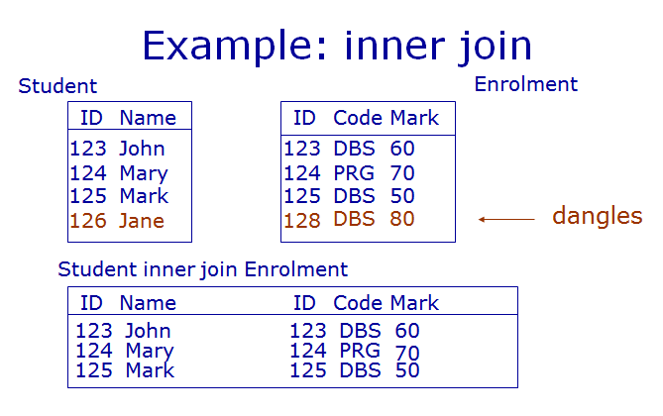

Slide 44
Outer Join
When we take the join of two relations we match up tuples which share values
Some tuples have no match, and are ‘lost’ these are called ‘dangles’
Outer joins include dangles in the result and use NULLs to fill in the blanks
Left outer join
Right outer join
Full outer join

Slide 45
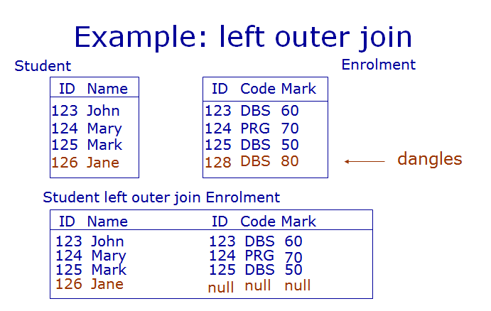

Slide 46
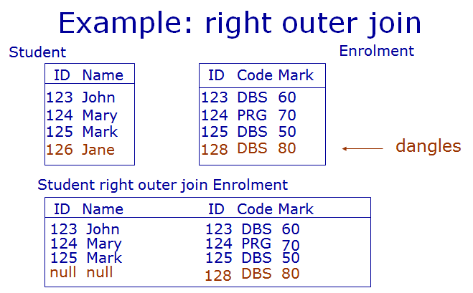

Slide 47
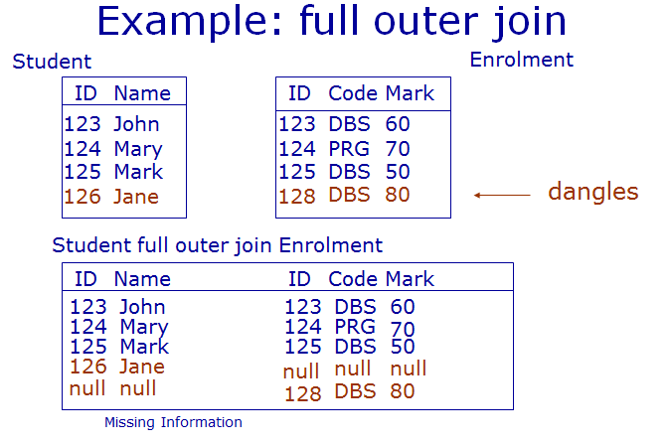

Slide 48
Outer Join Syntax
SELECT <cols> FROM <table1> <type> OUTER JOIN <table2> ON <condition>
Example:
SELECT * FROM Student FULL OUTER JOIN Enrolment ON
Student.ID = Enrolment.ID

